Slide 1
Method of Water conservation
Topic: Rainwater Harvesting
Prepared by: Himesh Maniyar, Sanket Banait, Priyanshu Kasliwal

Slide 2
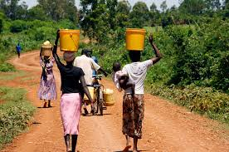
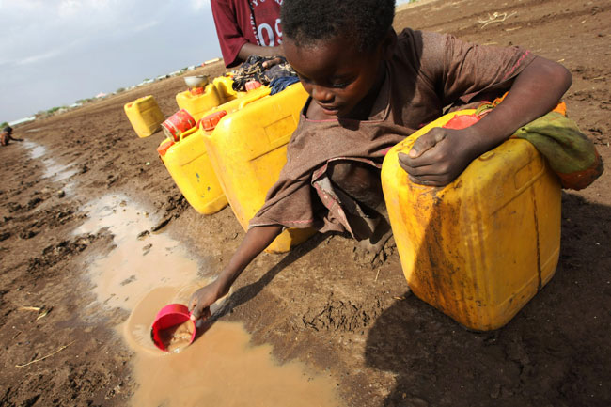
Need of water conservation
We need to conserve water because of the following reasons:
Demand for water is on rise due to the increase in population and urban centers in the country.
Many water resources like rivers, lakes, ponds etc. are getting polluted.
Overuse of water has resulted in the lowering of water table in many regions.
Global warming has led to climatic changes. This has resulted in repeated droughts in several countries.
These two shown images can clearly tell us the
condition of humans without water.

Slide 3
What is the need of rain water harvesting
Groundwater is the primary source of freshwater that caters to the demand of ever-growing domestic, agrarian and industrial sectors of the country.
Over the years, it has been observed that the necessity for the exploitation of groundwater resources for various everyday needs, like bathing, cleaning, agriculture, drinking water, and industrial activities directly/indirectly creates tremendous water wastage.
In cities, much of the rain that falls on buildings, roofs, roads, and other hard landscaping does not percolate into the soil and is instead directed into storm sewers for disposal.
During dry months, local groundwater is depleted, and many localities struggle to consistently provide enough potable water to meet demand.

Slide 4
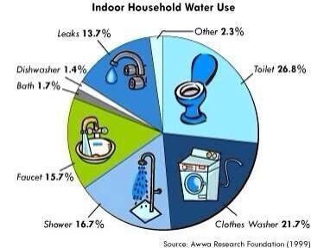

Slide 5
WHAT IS RAINWATER HARVESTING
Rainwater harvesting system, also called rainwater catchment system, is the employment of technology that collects and stores rainwater for human use and replenishes the groundwater as well.
Adopting rainwater harvesting and recharging groundwater is one of the simplest and best measures in conserving water globally.
Rainwater harvesting is one of the simplest and oldest methods of self-supply of water for households, and residential and household-scale projects.

Slide 6
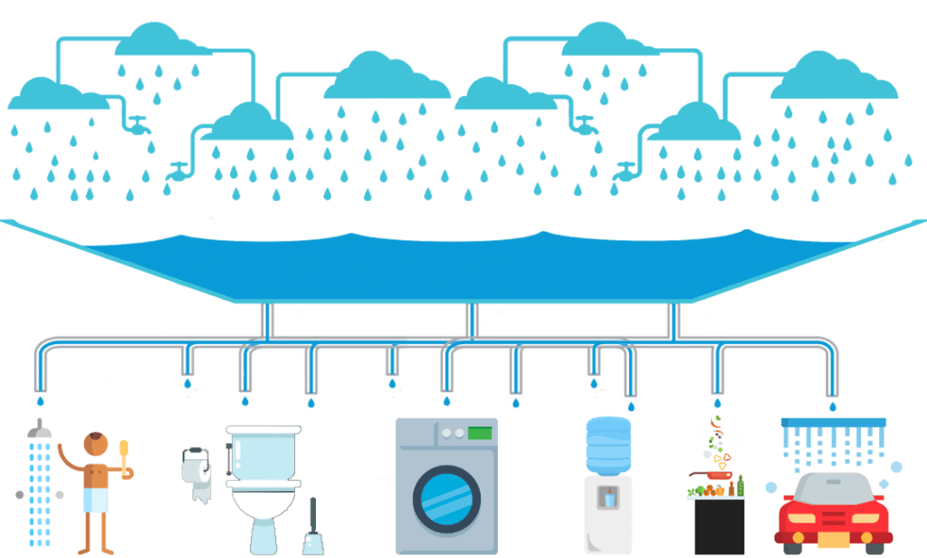
Basic skeleton of rainwater harvesting

Slide 7
HOW rainwater harvesting IS PRACTICED
The process involves collection and storage of rainwater with help of artificially designed systems, that runs off natural or man-made catchment areas e.g. rooftop, rocky surface, hill slopes.
Water harvesting can be undertaken through a variety of ways. These are:
  Capturing runoff from rooftops.
  Capturing runoff from local catchments.
  Conserving water through watershed management.
The collected rainwater from surfaces on which rain falls may be filtered, stored and utilized in different ways or directly used for recharge purposes.
Rainwater Harvesting doesn’t contain any kind of impurity, with relatively less storage cost and no maintenance cost involved except for periodical cleaning.

Slide 8
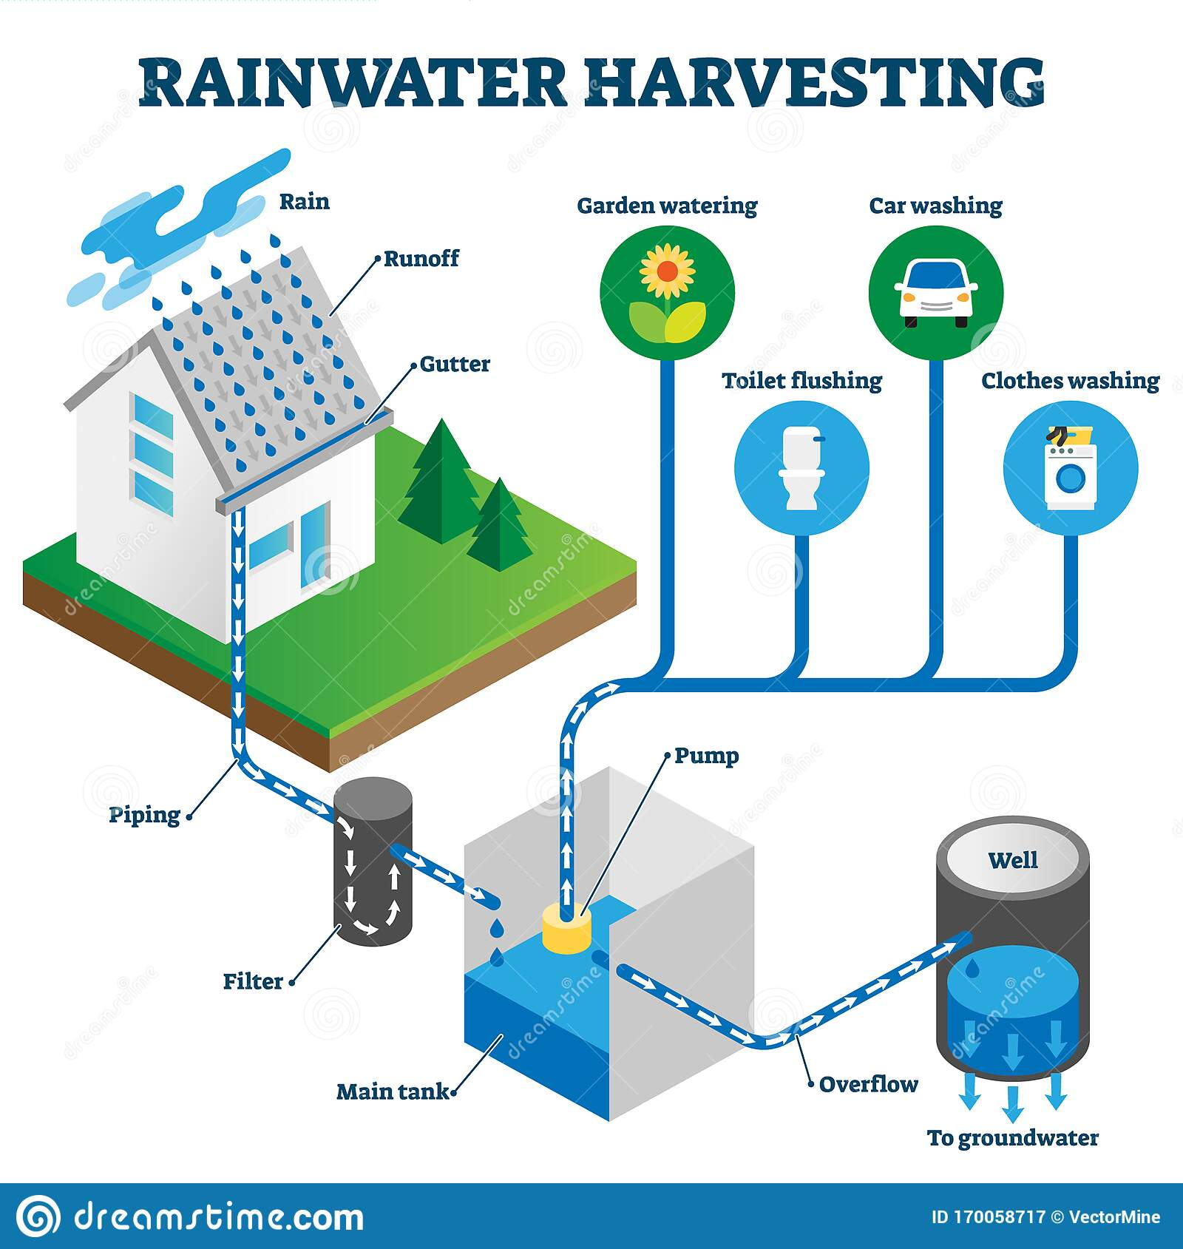
Rainwater harvesting at individual level

Slide 9
HOW rainwater harvesting IS PRACTICED IN ANCIENT INDIA
Around 300 BC, Kutch, India, used rainwater harvesting for agriculture and many other uses.
Rainwater harvesting was done by Chola kings as well.
Rainwater from the Brihadeeswarar temple in Thanjavur was collected in Shivaganga tank.
During the later Chola period, the Viranam tank was built in Tamil Nadu to store water for drinking and irrigation purposes.
The technology of rainwater harvesting is deeply rooted in the spirit of India with a variety of ancient methods which are still found today which include:
  Talibs: Medium to large sized reservoirs that provide irrigation for plants as well as drinking.
  Johads: Dams that are used to capture and keep rainwater.
  Baoris: Wells dug into the ground are still often used for drinking.
  Jhalaras: Specially constructed tanks that are used for the local community and religious purposes.

Slide 10
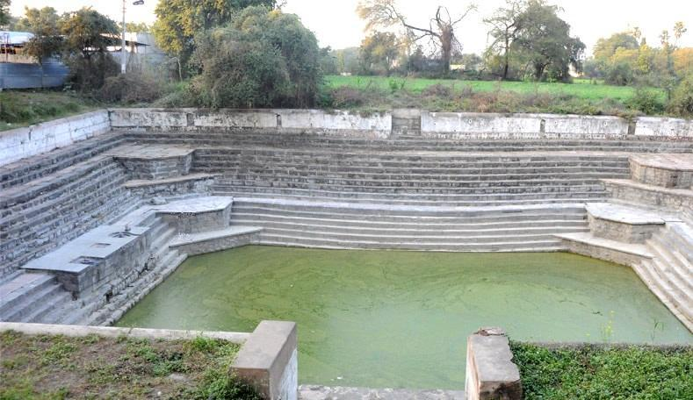
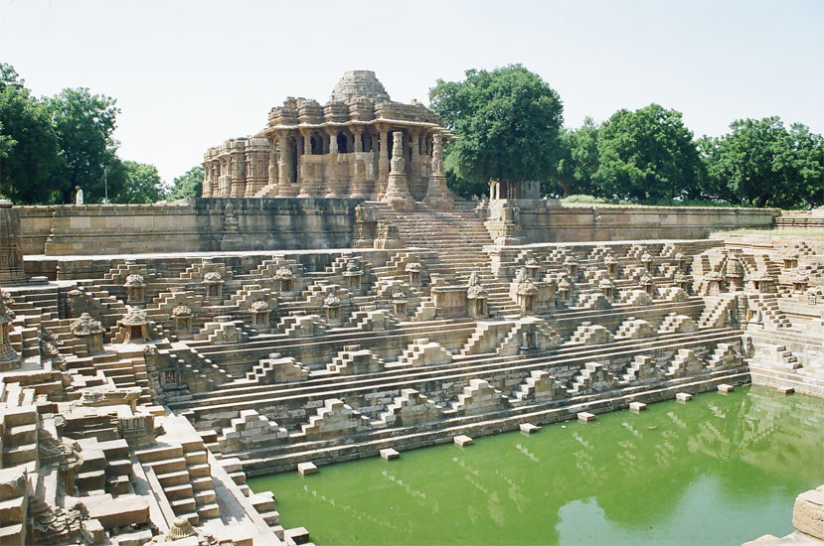
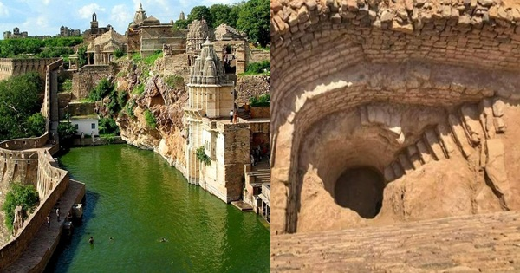
Some images of ancient rain water harvesting

Slide 11
ADVANTAGES OF RAINWATER HARVESTING
The all-around expenditures is much cheaper compared to other purifying or pumping means.
Rainwater harvesting systems are cost-effective, provide high-quality water, lessen dependence on wells and are considerably easy to maintain.
It minimizes the impacts of flooding by funnelling the off-water into large tanks for recycling.
It helps reduce the load placed upon drainage systems.
No land is wasted for storage purpose and no population displacement is implicated therefore, groundwater is not directly exposed to evaporation and pollution.
It reduces soil erosion and flood hazards by collecting rainwater
It reduces the flow of storm-water to prevent urban flooding.
It mitigates the effects of drought.
Rainwater is mostly free from harmful chemicals, which makes it suitable for irrigation purposes.
It increases the productivity of aquifer resulting in the rise of groundwater levels

Slide 12
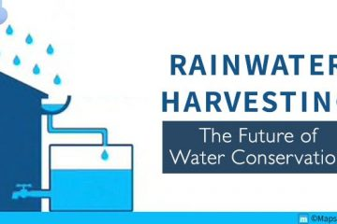
Methods of Rainwater harvesting adopted in rural and urban areas
1. Surface runoff harvesting
In this method, rainwater flows away as surface runoff and can be stored for future use. Surface water can be stored by diverting the flow of small creeks into reservoirs on the surface or underground. It can provide water for farming, for cattle and also for general domestic use. Surface runoff harvesting is most suitable in urban areas.
Rooftop rainwater/storm runoff can be harvested in urban areas through:
• Recharge Pit
• Recharge Trench
• Tubewell
• Recharge Well

Slide 13
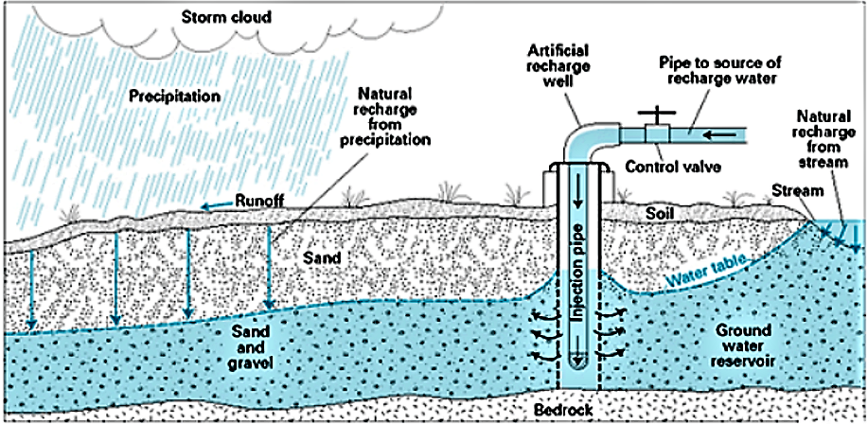
2. Groundwater recharge
Groundwater recharge is a process where water moves downward from surface water to groundwater. The surplus rainwater can then be used to recharge groundwater through artificial recharge techniques.
Rainwater in rural areas can be harvested through:
• Gully Plug
• Dug well Recharge
• Percolation Tank
• Check Dam

Slide 14
TRADITIONAL RAINWATER HARVESTING IN INDIA which are still present
Himalayan Region
Zing -Tanks for collecting water from melted ice in Ladakh.
Kul -Water channels in mountain areas of Jammu, Himachal Pradesh.
Eastern Himalayas
Bamboo drip irrigation – Water from streams in the hills is brought to the plains via bamboo pipes for drip irrigation in Meghalaya
Brahmaputra Valley
Dongs – Ponds in Assam

Slide 15
TRADITIONAL RAINWATER HARVESTING IN INDIA which are still present
Indo-Gangetic Plain
Baolis – secular structured stepwells from which everyone could draw water and use for washing and bathing.
Thar Desert
Baoris -Community wells in Rajasthan
Tankas -Underground tank Bikaner in Rajasthan
Kund – a circular underground well; having a saucer-shaped catchment area that gently slopes towards the center where the well is situated.

Slide 16
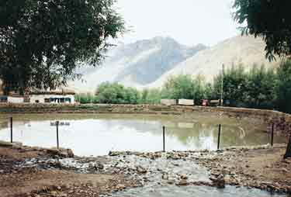
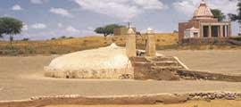
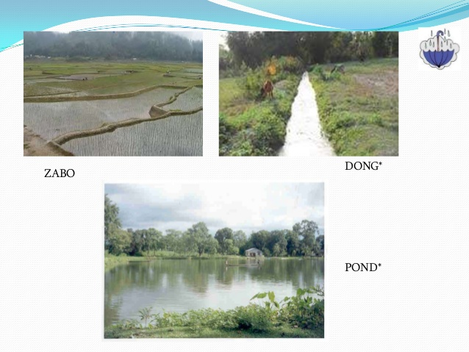
Rain Water Harvesting in Trans Himalayan region
Rain Water Harvesting in Thar Desert
Rain Water Harvesting in Brahmaputra valley

Slide 17
TAMILNADU CASE STUDY OF RAINWATER HARVESTING
The Rain Water Harvesting movement launched in 2001.
It has had a tremendous impact in recharging the groundwater table all over Tamil Nadu.
Amendments made to Section 215 (a) of the Tamil Nadu District Municipalities Act, 1920 and Building Rules 1973, have made it mandatory to provide RWH structures in all new buildings.
Action Plan for IEC Activities
  Conduction of awareness programme with the coordination of Self Help Groups, Welfare Associations, and NGO’s and school children.
  Setting up hoardings displaying the importance and benefits of the Rain Water Harvesting.
  Door to Door campaign on Rain water harvesting with the participation of SHGs, NGOs.

Slide 18
Action plan for harvesting campus rain water
Provision of rain water harvesting structures would also been monitored under Section 215 A of the Tamil Nadu District Municipalities Act, while giving plan approval.
Rain Water Harvesting Structures have been provided in buildings due to Town Panchayats Department.
Necessary action taken to provide adequate Rain Water harvesting structures.
Necessary action to rejuvenate existing Rain Water Harvesting structures.
The scheme has helped people in water-starved regions such as Chennai by raising water tables in most neighbourhoods. Chennai had a 50% rise in water level in five years and the water quality significantly improved.

Slide 19
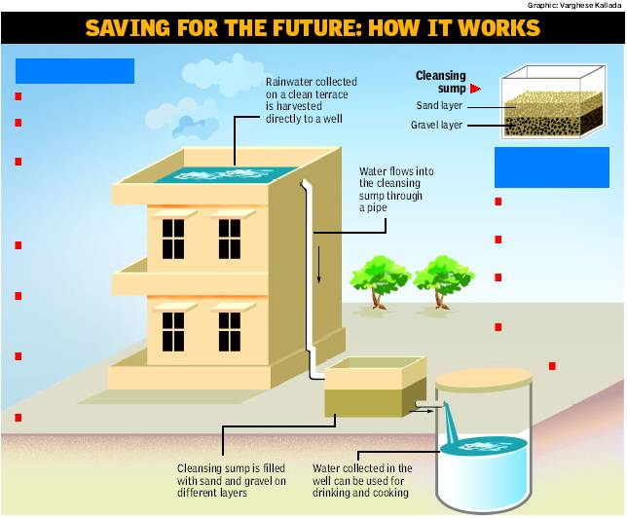
Rain Water Harvesting system of Chennai

Slide 20
OTHER STATES IMPLEMENTING RAINWATER HARVESTING
As a consequence of diminishing groundwater levels, many state governments implemented the idea of rainwater harvesting.
In Bangalore, adoption of rainwater harvesting is mandatory for every owner or the occupier of a building
In Rajasthan, rainwater harvesting has traditionally been practiced by the people of the Thar Desert. Many ancient water harvesting systems in Rajasthan have now been revived. Water harvesting systems are widely used in other areas of Rajasthan, as well, for example, the chauka system from the Jaipur district.
At present, in Pune, rainwater harvesting is compulsory for any new housing society to be registered.
In Mumbai, the Municipal Corporation of Greater Mumbai is planning to make rainwater harvesting mandatory for large societies.
The Central Ground Water Authority (CGWA) has made rainwater harvesting mandatory in all institutions and residential colonies in notified areas (South and South-west Delhi and adjoining areas like Faridabad, Gurgaon and Ghaziabad).

Slide 21
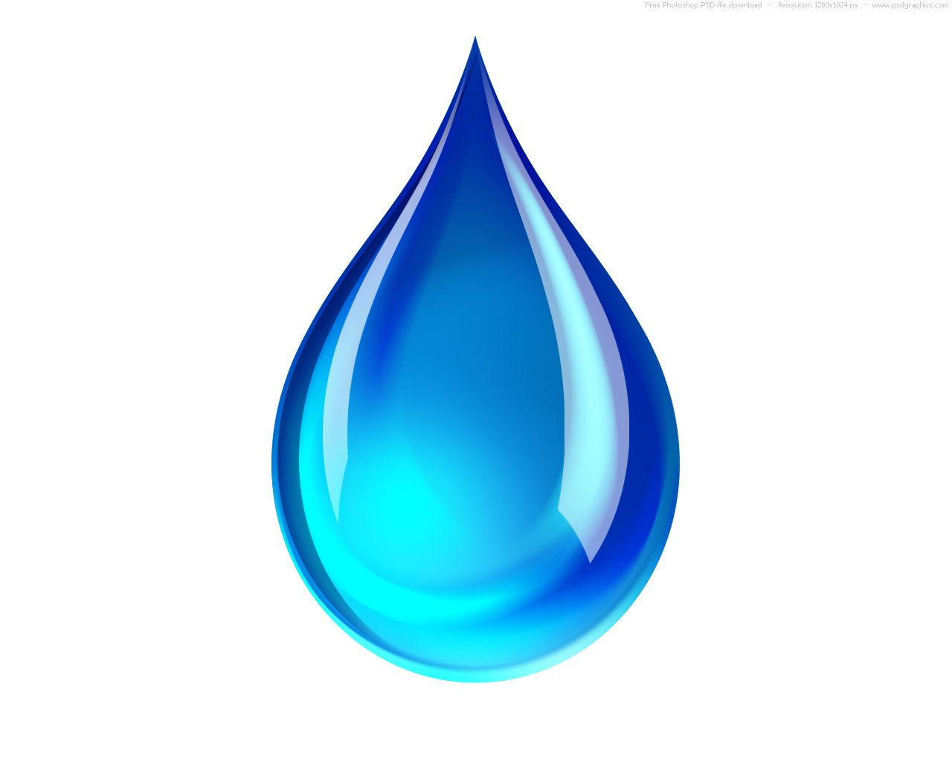
THANK Y U

